Slide 1
Reward Processing Mobile Application

Slide 2
Overview
Introduction
Problems and Solutions
Current State
Future Plans
Notes:
Intro - Kaushiki
Problems and solutions - Yichen
Current state - Haixin, Wren
Chongqi (Game map)
Kaushiki, Wren (Game rules)
Future Plans - Haixin and Wren

Slide 3
Introduction
1

Slide 4
Project Description
Clients and their research
Monitor decision-making skills in response to an individual’s mood using a gamified approach
Questionnaire
Arcade-style game (Pacman)

Slide 5
App Development
Flutter (iOS and Android)
Dart
Firebase

Slide 6
Problems and Solutions
2

Slide 7
Problems
Solutions
Miscommunication within the team
Data storage
Client meeting
Update everyone in the team on every progress done
Online resources
Send the app progress with detailed explanation via email

Slide 8
Current State
3

Slide 9
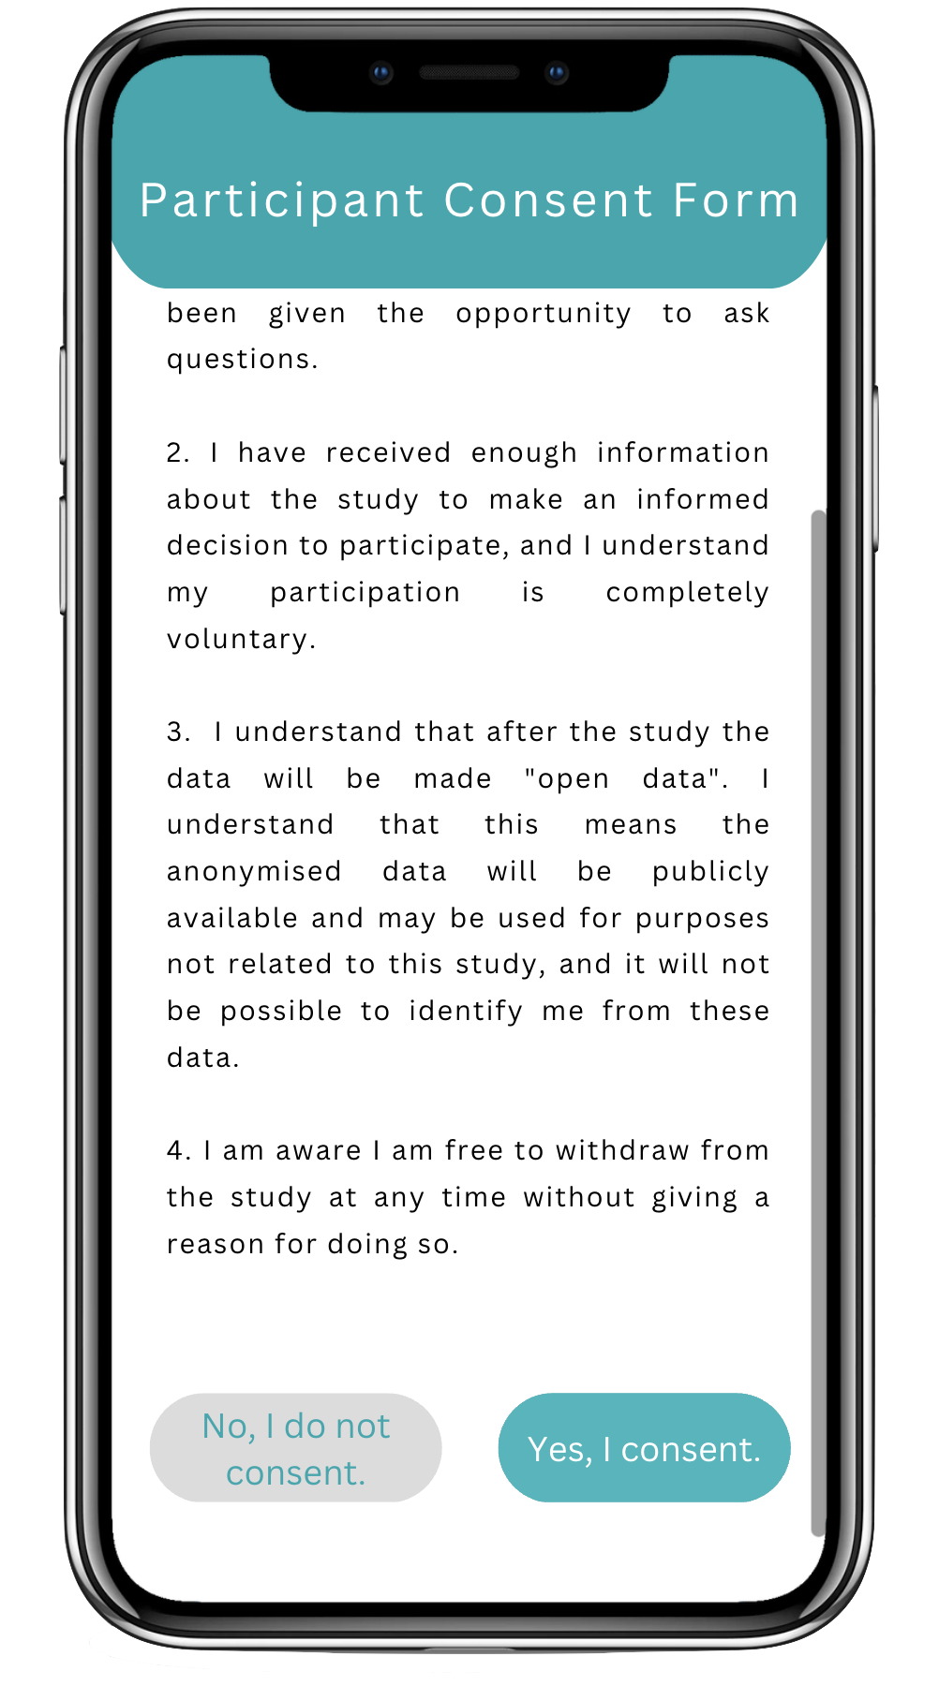
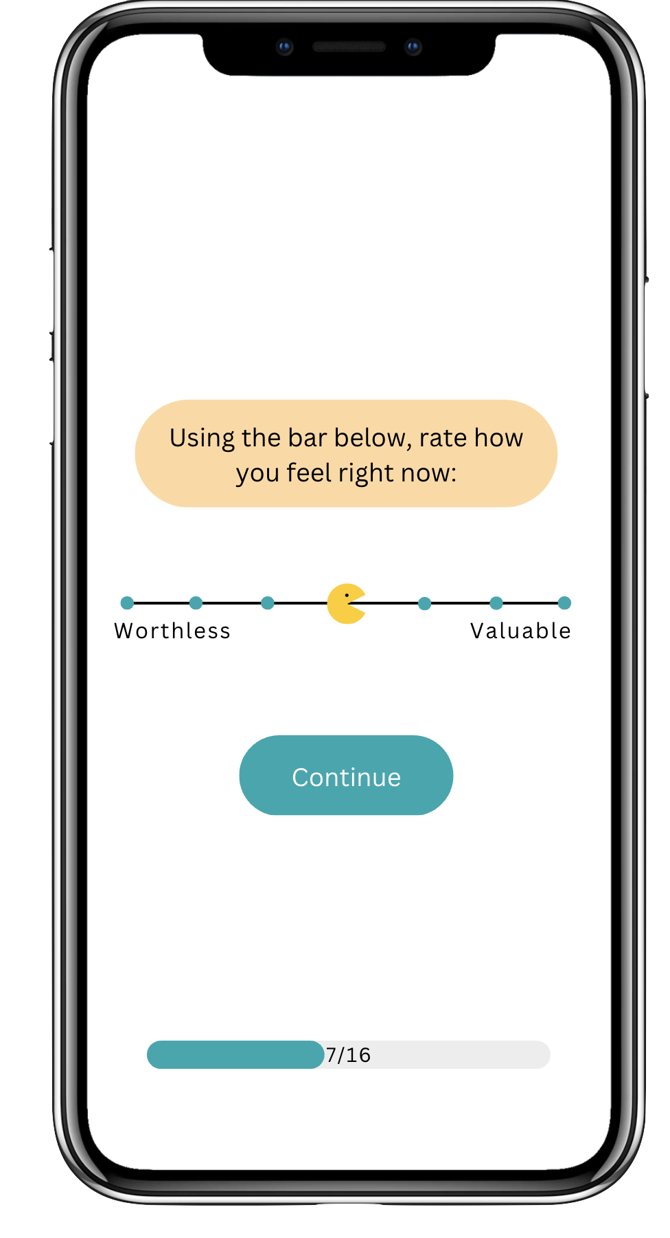
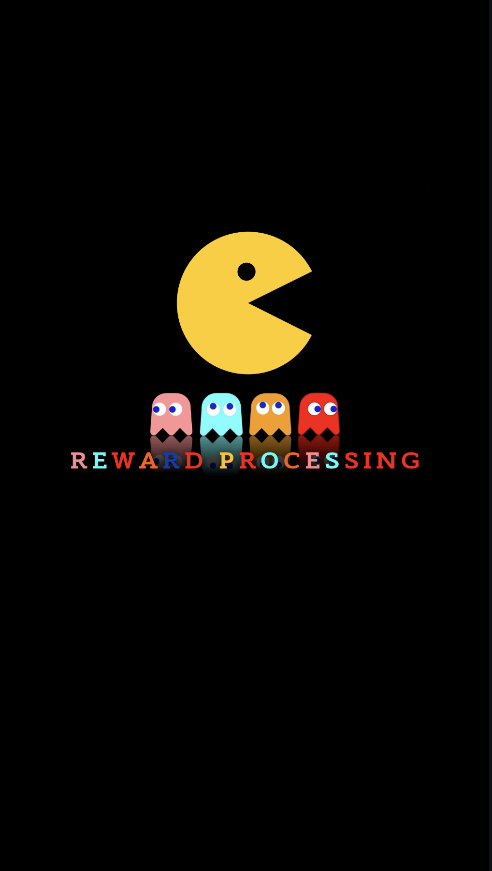
Designs
Notes:
Wren - Add progress bar and changed the rating button to pacman.

Slide 10

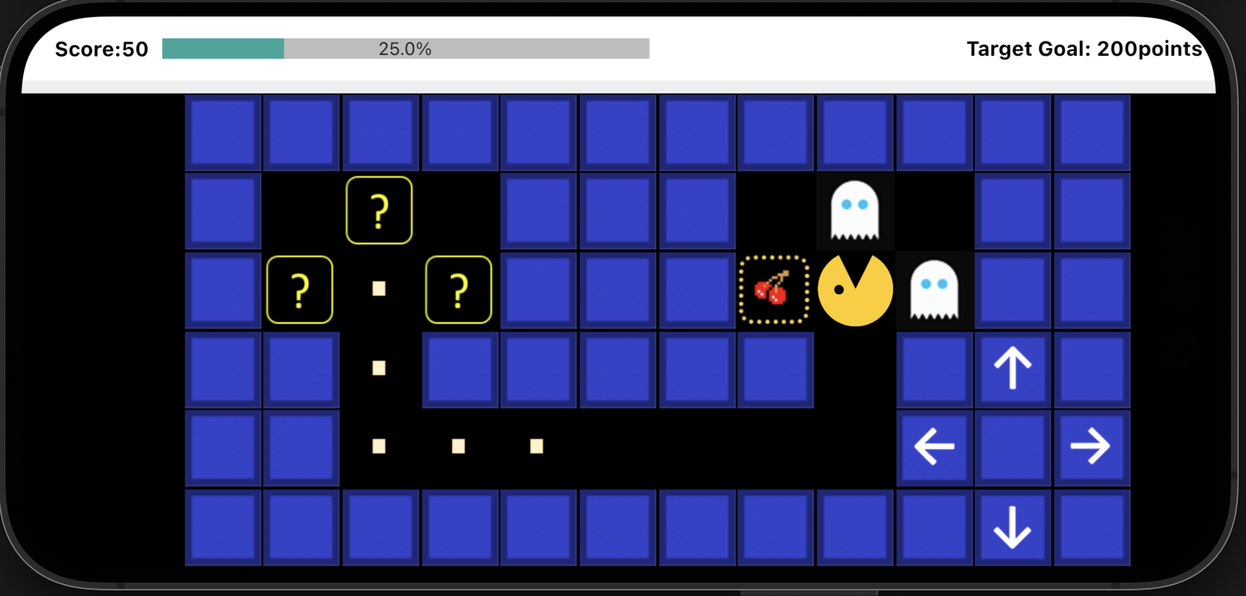



Game Map
Notes:
Show them the movement (a video?)
Mention that the client requested for the navigation panel to be on the right side of the phone

Slide 11
Game Rules
Use the arrows to move the pacman
Click on the guess box to see what’s inside
If you find a cherry, click on it to gain points
If you find ghosts, leave and do not touch them
If the box is empty, you can either keep finding cherries on the same side or move to the other side

Slide 12


Slide 13

Data Storage
Firebase
Provided by Google
NoSQL database
Real-time data storing
Online resources
Notes:
Wren

Slide 14
Notes:
Wren

Slide 15
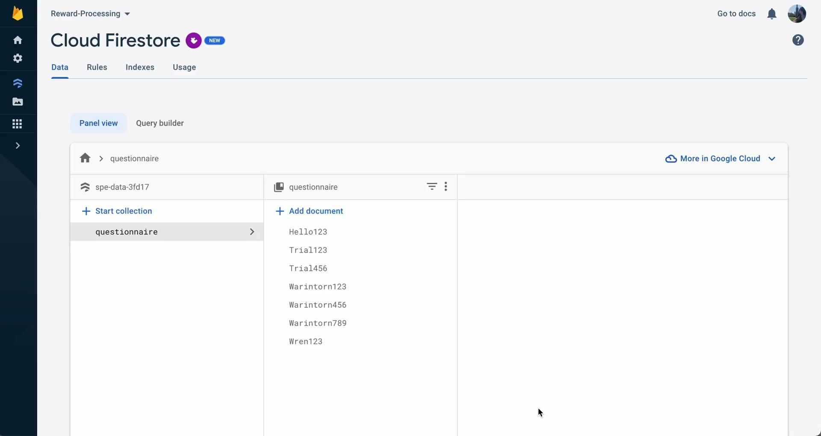

Slide 16
Future Plans
4

Slide 17
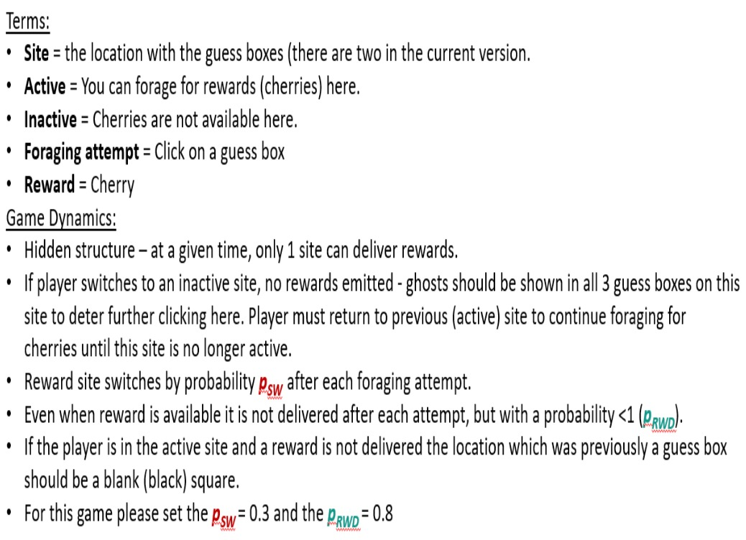
Store data of the game
Rearrange the game grid
Modify the game logic
Launch the application

Slide 18
Thank you for listening!

